Slide 1
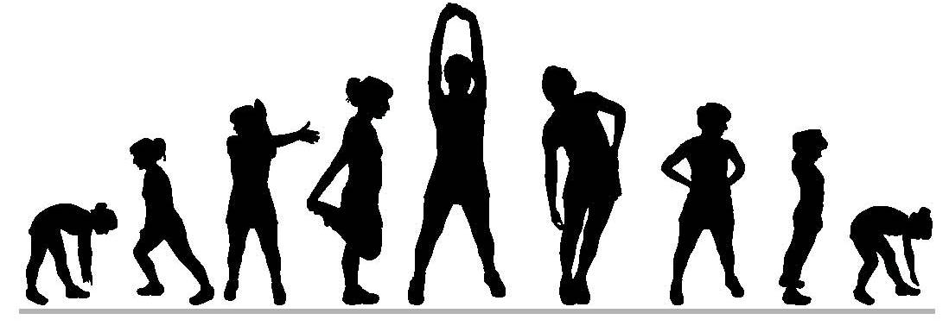
Exercise Video Library #1

Slide 2
Table of Contents
3. Butt Kicks
4. Calf Raises
5. Crunches
6. Forward Arm Claps
7. High Knee March
8. Inch Worm
9. Jumping Jacks
10. Knee Hugs
11. Leg Pulls
12. Leg Raises
13. Leg Sweeps
14. Overhead Arm Clap
15. Planks
16. Push-ups
17. Reverse Lunge Twist
18. Russian Twist
19. Side Lunges
20. Skipping
21. Squats
22. Standing Quad Stretch
23. Supermans
24. Wall Push-ups

Slide 3
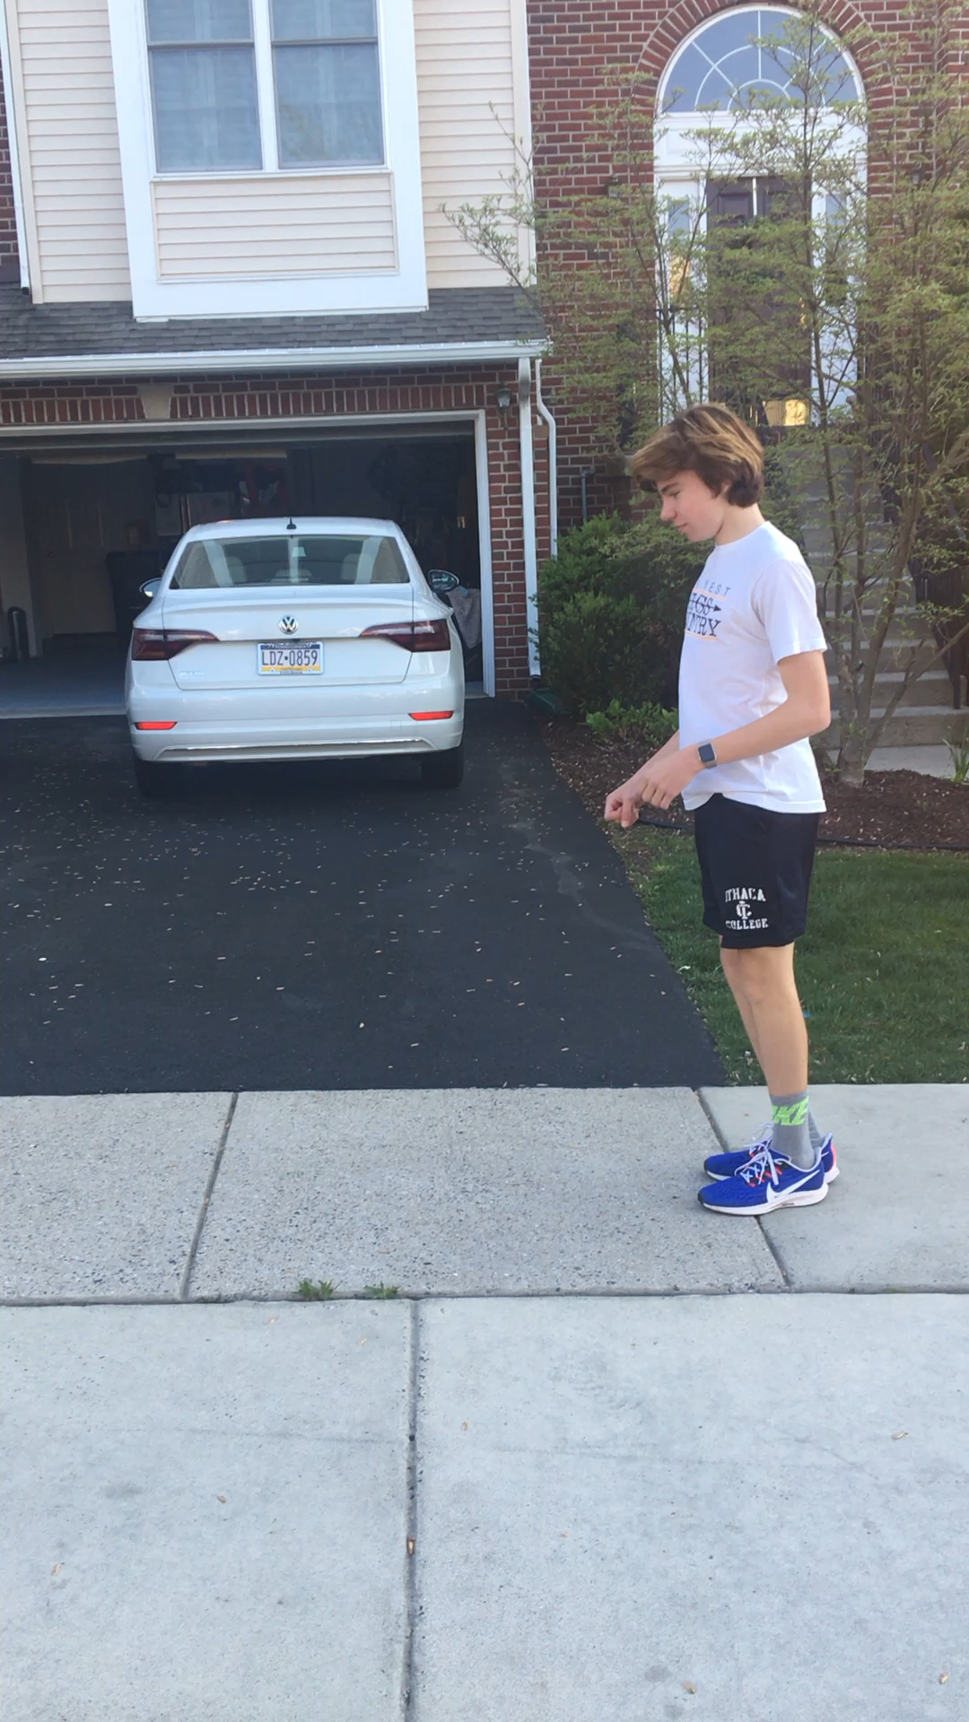
Butt Kicks

Slide 4
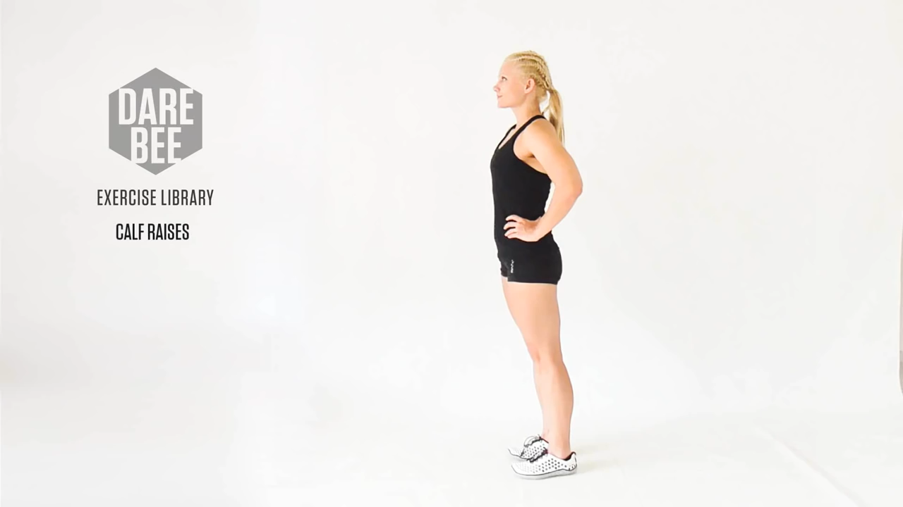
Calf Raises

Slide 5
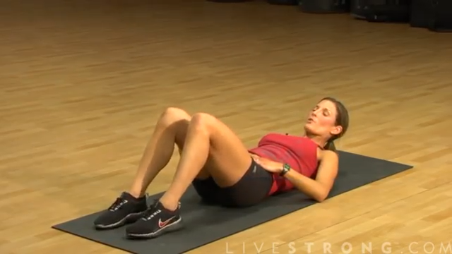
Crunches

Slide 6
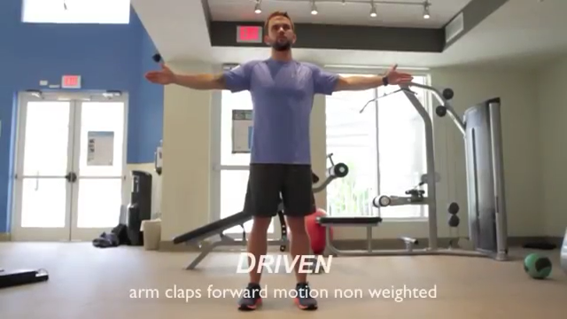
Forward Arm Claps

Slide 7
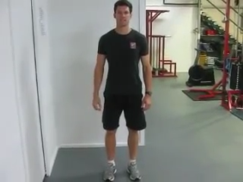
High Knee March

Slide 8
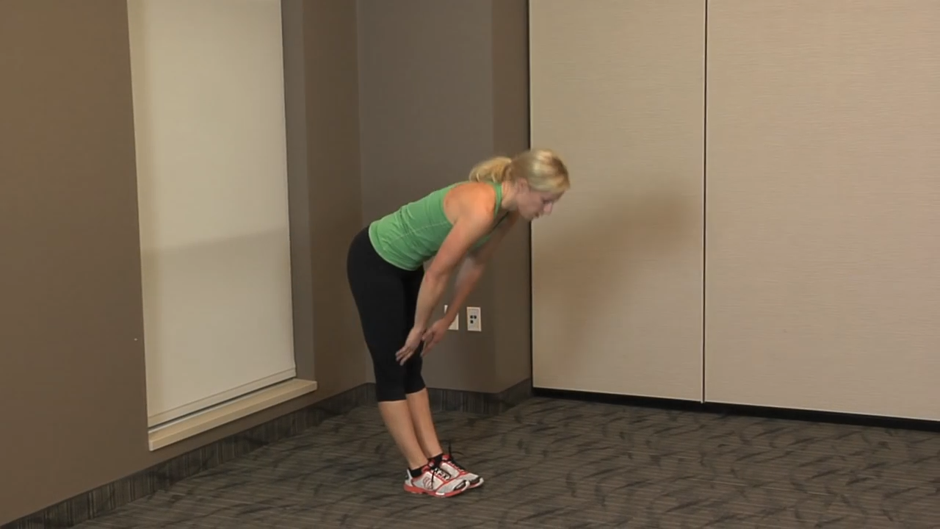
Inch Worm

Slide 9
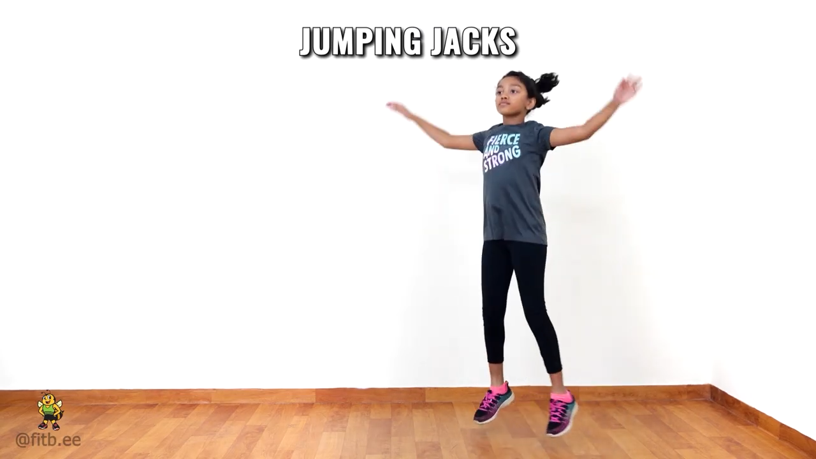
Jumping Jacks

Slide 10
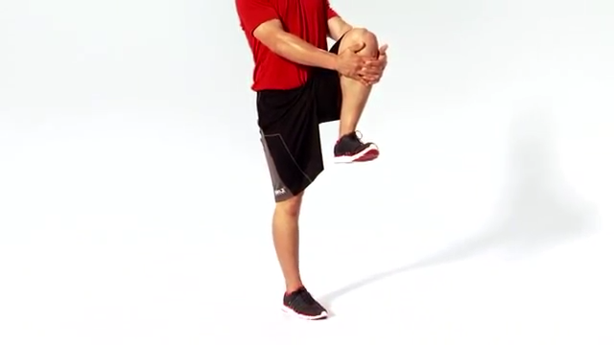
Knee Hugs

Slide 11
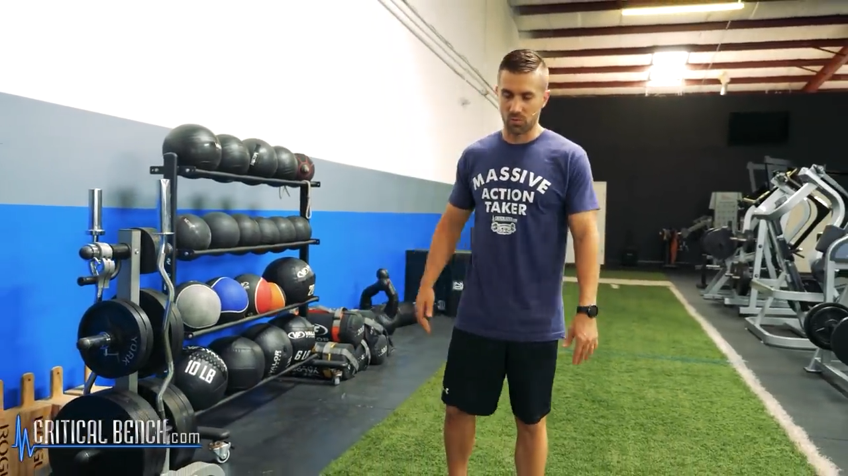
Leg Pulls

Slide 12
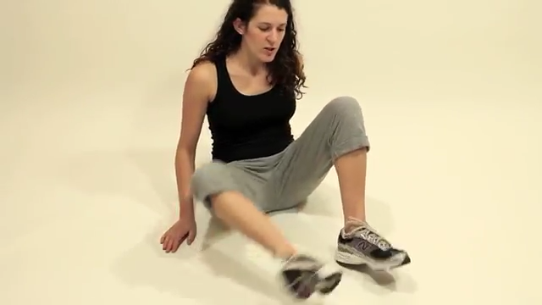
Leg Raises

Slide 13
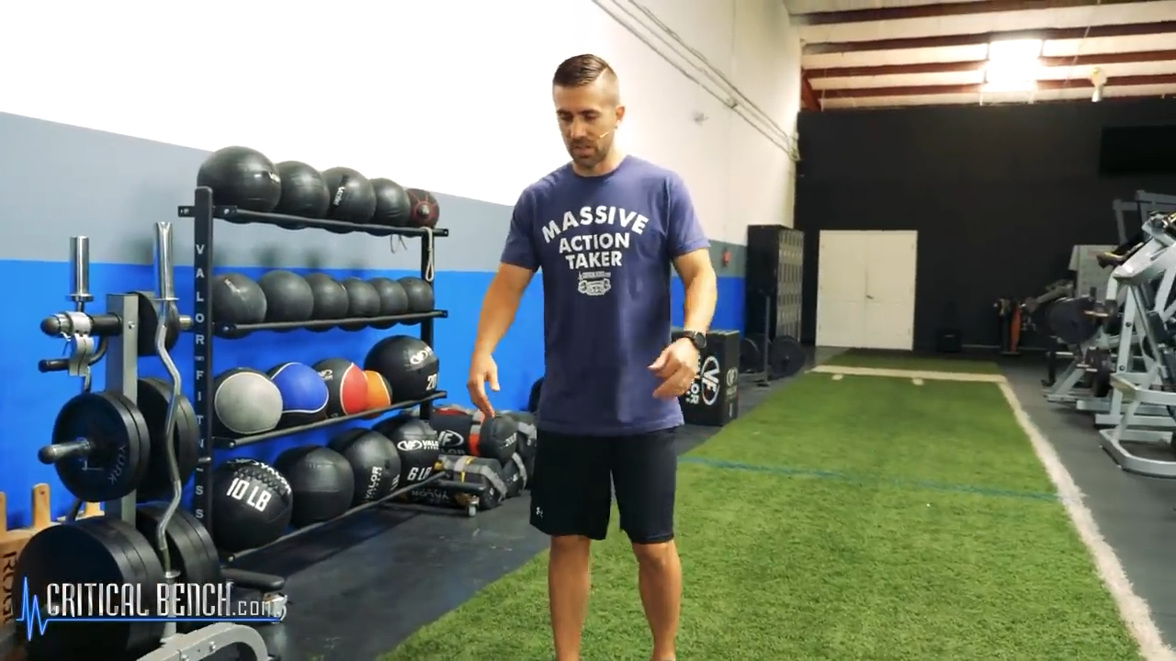
Leg Sweeps

Slide 14
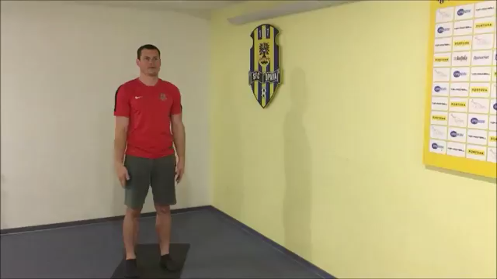
Overhead Arm Clap

Slide 15
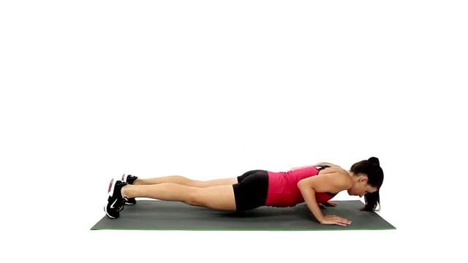
Planks

Slide 16
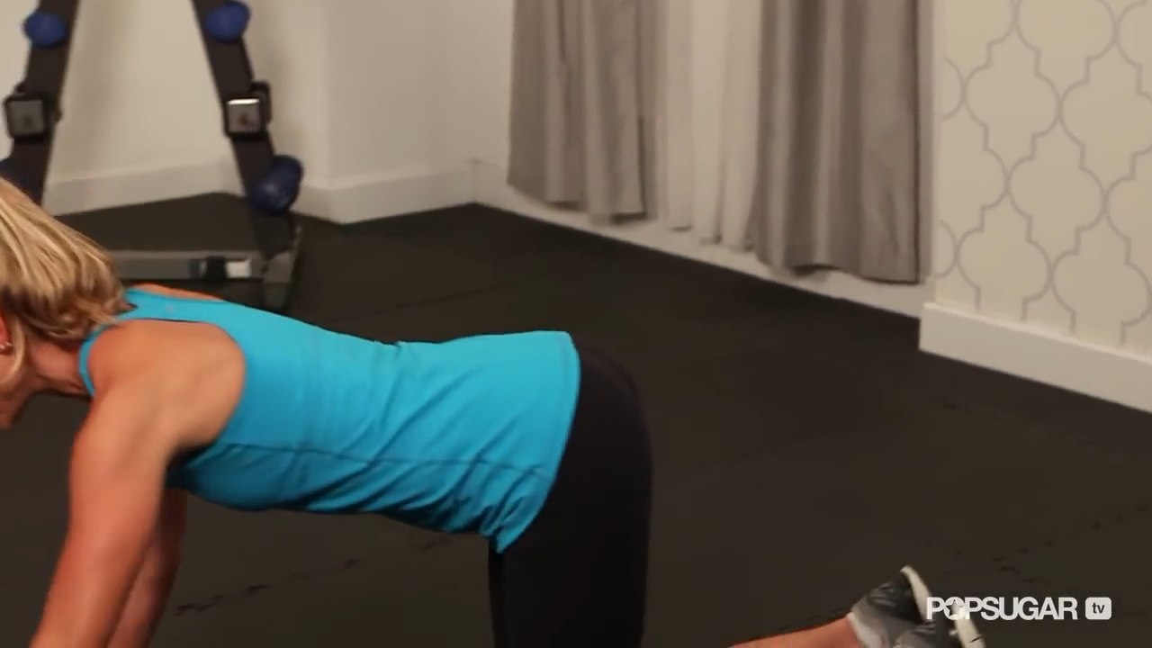
Push-ups

Slide 17
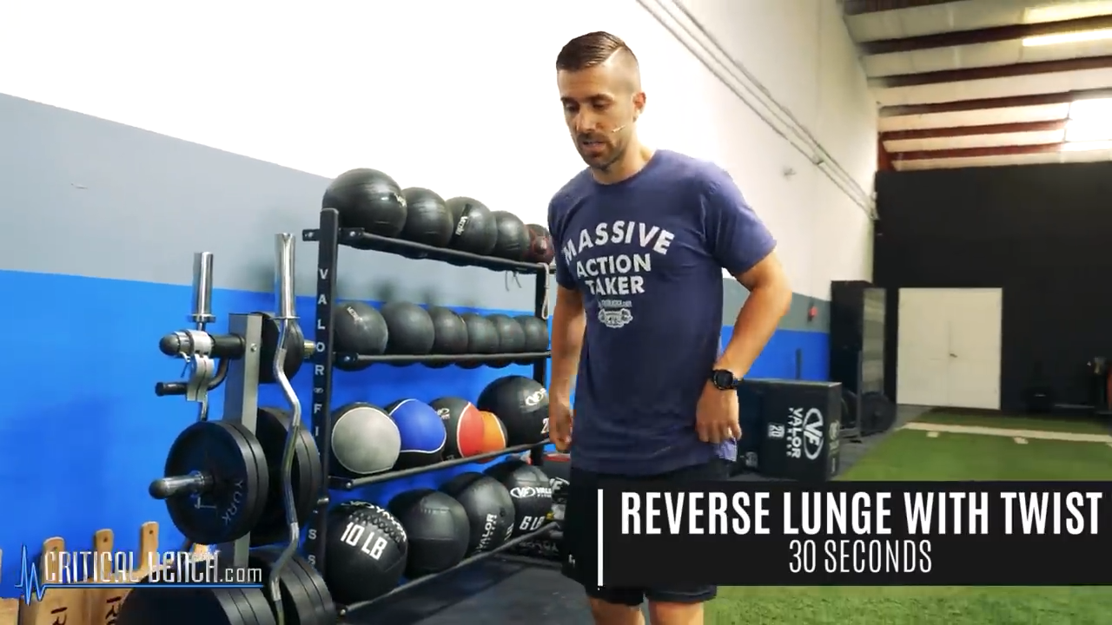
Reverse Lunge Twist

Slide 18
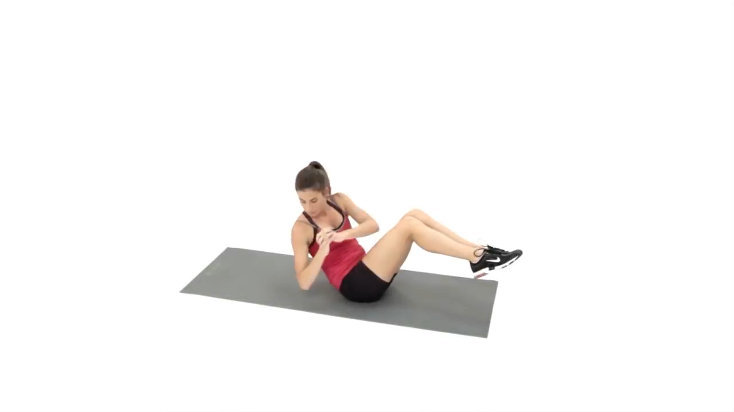
Russian Twist

Slide 19
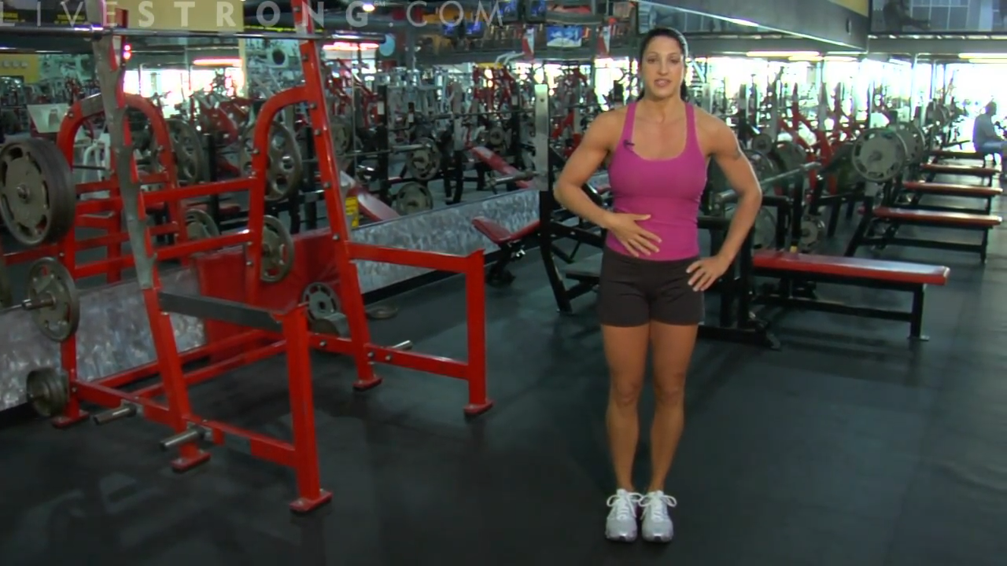
Side Lunges

Slide 20
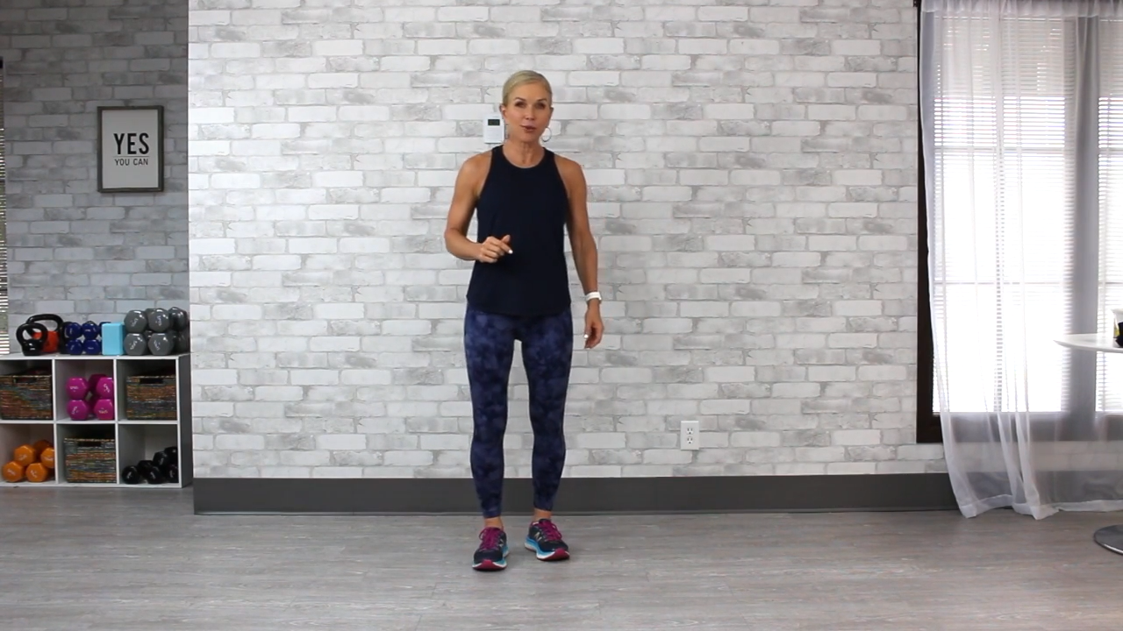
Skipping

Slide 21
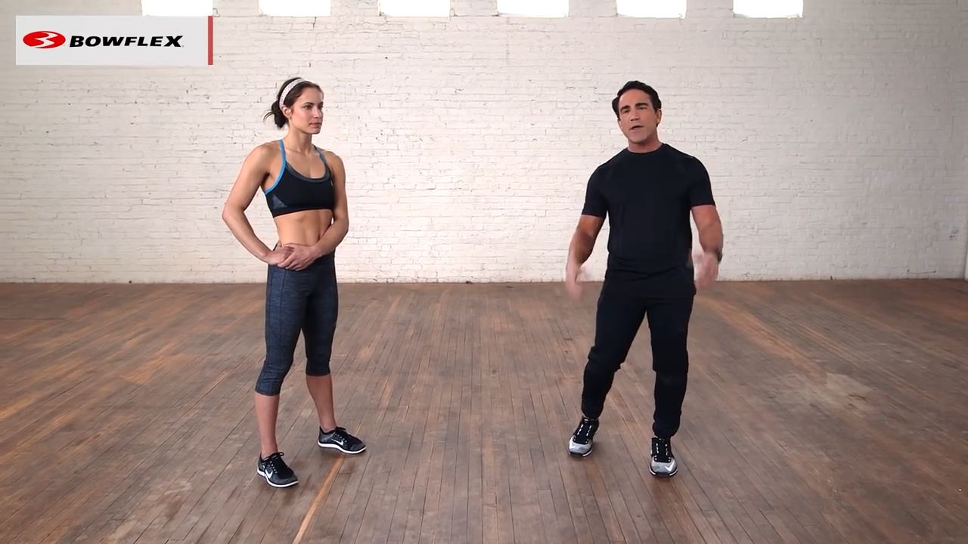
squats

Slide 22
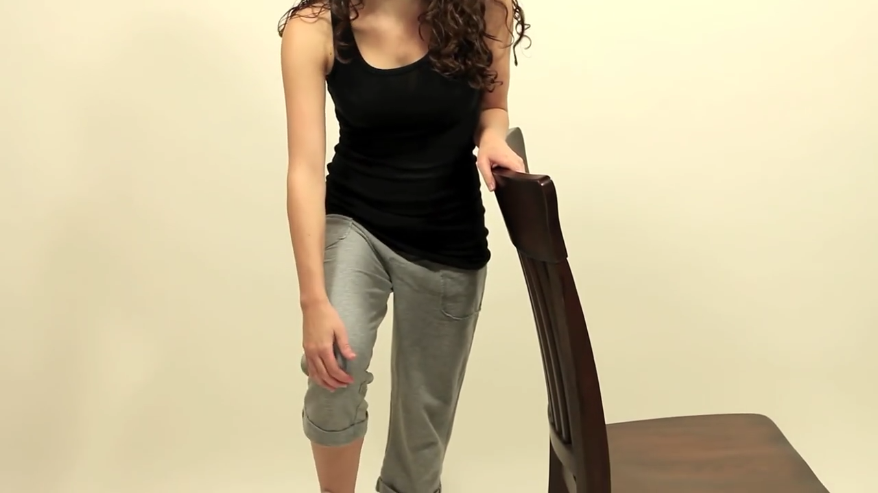
Standing Quad Stretch

Slide 23
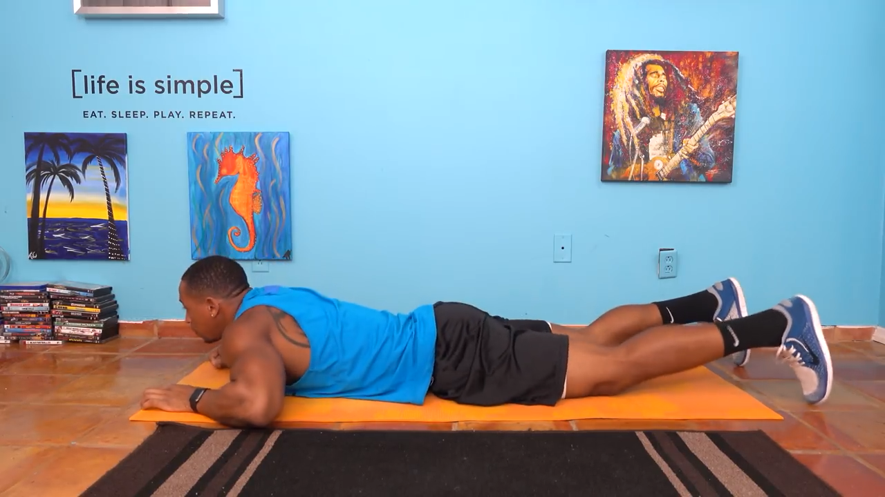
Superman

Slide 24
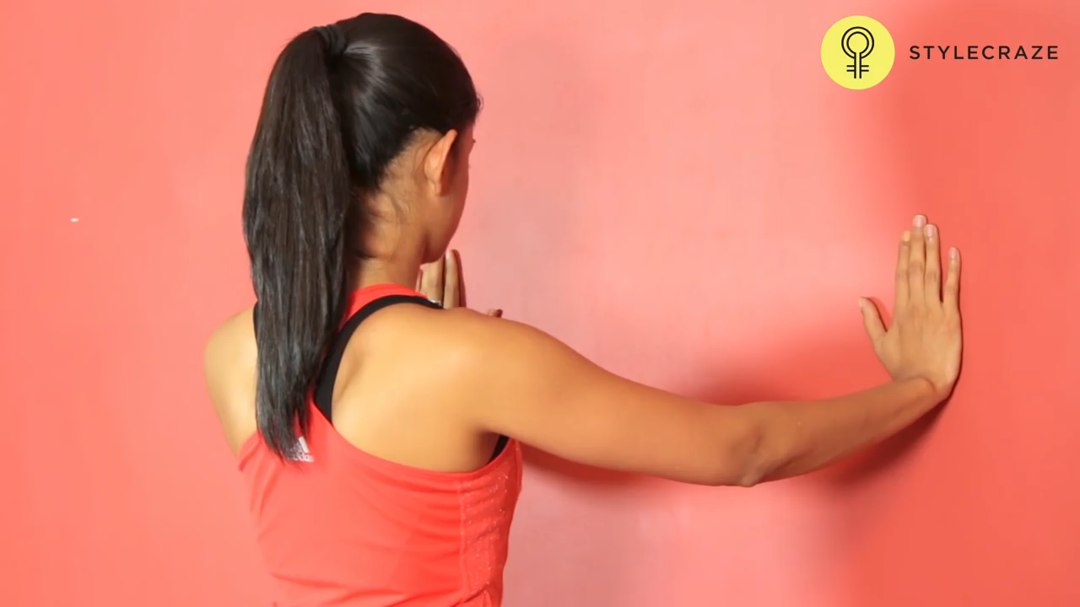
Wall Pushups

