Slide 1


Slide 2
What is Genius Hour?
Exploring your own interests, inquiries, and wonderings
Researching
Testing your own investigations
Sharing your findings with others

Slide 3


Slide 4


Slide 5
What does Genius Hour look like in our classroom?
What interests, inquiries, and wonderings do you have from our Weather Unit?
Think about your topic and question over your Thanksgiving break.
Select your topic by the time you return.
Research your topic in school.
Plan and test an investigation. Collect your materials at home.
Share your findings with others.

Slide 6

Day 1 – Research your question
Come prepared to class with your question.
Use your class time to research your question and collect scientific information

Slide 7
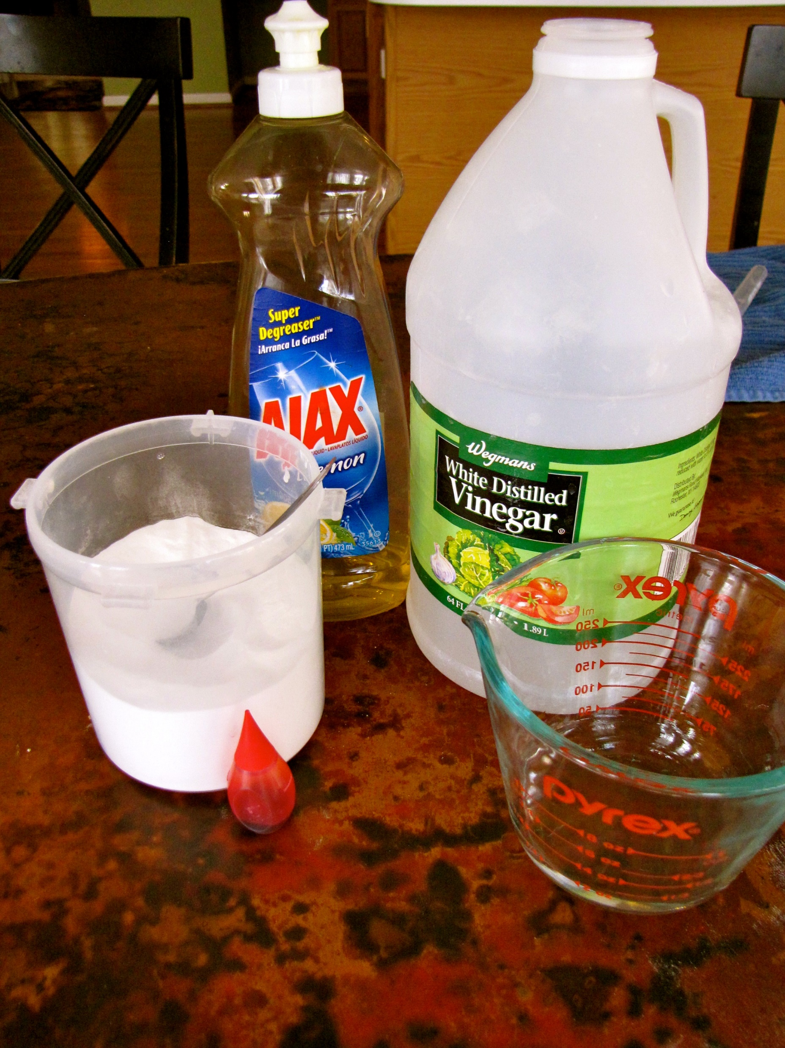
Day 2 – Plan your investigation
Research and plan your investigation.
Collect your materials from home and school.

Slide 8
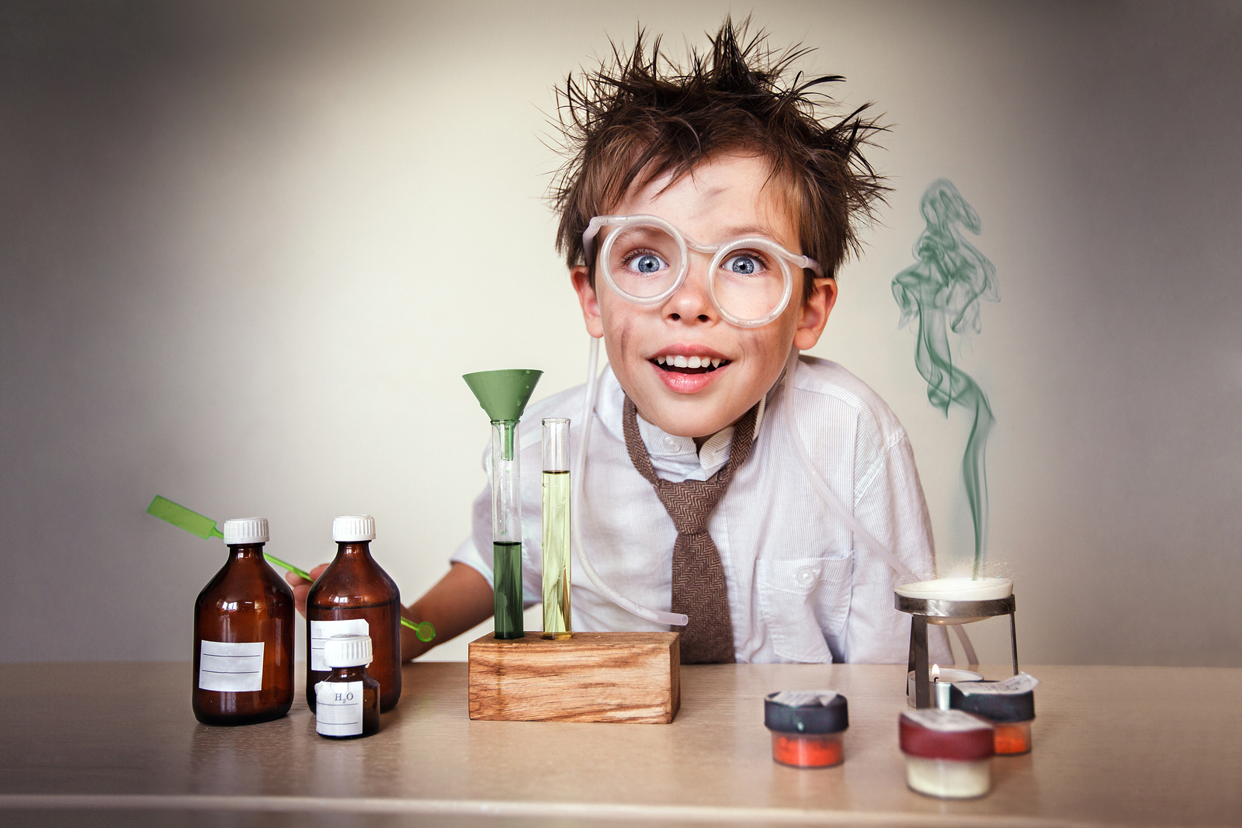
Day 3 – Test your investigation
Bring your materials to school.
Test your planned investigation and collect data.

Slide 9

Day 4 – Collect and share your findings
Show what you learned in your research and your investigation.
Can you answer your question with a claim? Do you have evidence?

Slide 10


