Slide 1
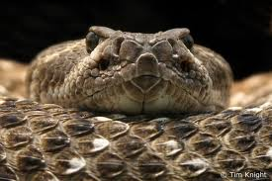
The rattlesnake is one of the most venomous creatures in North America.
I don’t think anyone wants to be bitten by one of these powerful reptilians.

Slide 2
Rattlesnakes
Tanner

Slide 3
How do rattlesnakes live in their natural habitat, and how do they affect humans?
How do rattlesnakes hunt, and what do they eat?
How do rattlesnakes disguise themselves and live in their natural habitat?
How do rattlesnakes affect humans?

Slide 4
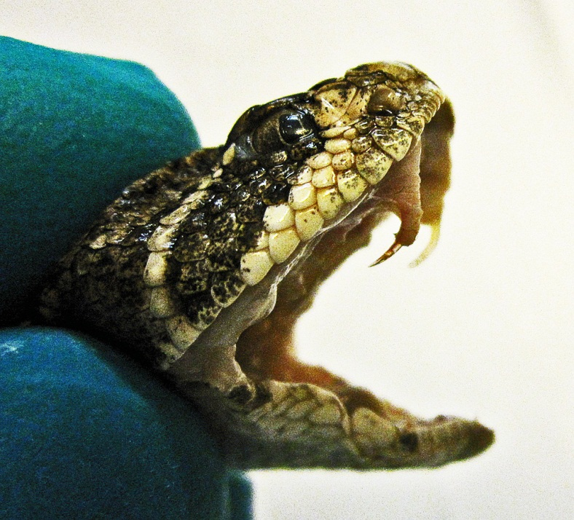
How do rattlesnakes hunt, and what do they eat?
Part 1
Special senses
Sensing body movement
“Pit”
Infrared/ good eyes
Hunting
“Sheath”
Fangs/poison gland
Multi-positional attack
Poison gland
Sheath
Fang

Slide 5
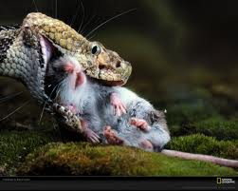
How do rattlesnakes hunt, and what do they eat?
Part 2
Diet
Reptiles/amphibians
Ground birds
Rodents
Small mammals
Warm-blooded animals

Slide 6
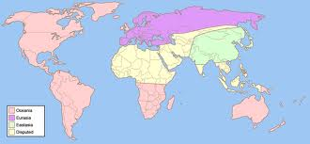
How do rattlesnakes disguise themselves and live in their natural habitat?
Western Hemisphere
Canada
USA
South/Central America
Over thirty species
Brown, black, tan, green
Young born in summer
Every molt another rattle ring
Rattle made of old molted skin

Slide 7
How do rattlesnakes affect humans?
Neurotoxin
“Pins and needles”
Attacks/kills nerves
Painless
Paralyze or death
Cytotoxin
Attacks blood/tissue
Pain/swelling
Death
Enzymes
Five to six enzymes

Slide 8
Rattlesnakes in Action

Slide 9
How do rattlesnakes live in their natural habitat, and how do they affect humans?
How do rattlesnakes hunt, and what do they eat?
How do rattlesnakes disguise themselves and live in their natural habitat?
How do rattlesnakes affect humans?
Infrared vision
Warm-blooded
Western Hemisphere
Camouflage
Neurotoxin
Cytotoxin

Slide 10
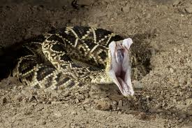
Now that you know the dangers of all types of rattlesnakes…
Make sure you do not run into their habitat without taking precautions.

