Slide 1
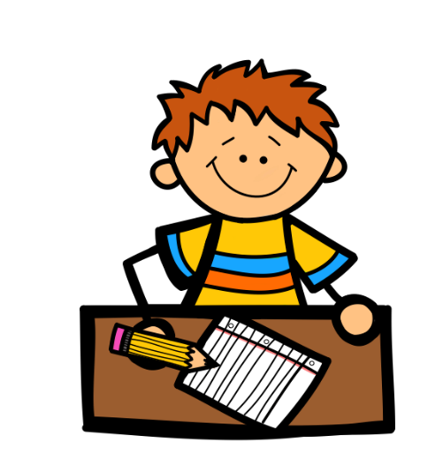
Kindergarten
Word Wall Words
A a am at and | B big | C can | D dad did | E | F for | G go | H has he have | I I in it is | J | K | L like love look | M mom me my | N no
O on | P play | Q | R | S see she said | T to the this | U up | V | W we will was with went | X | Y yes you | Z

