Slide 1
Welcome to Coffee & Conversation
Mrs. Taryn Barrett (A-L) & Mrs. Laura Ladley (M-Z)

Slide 2
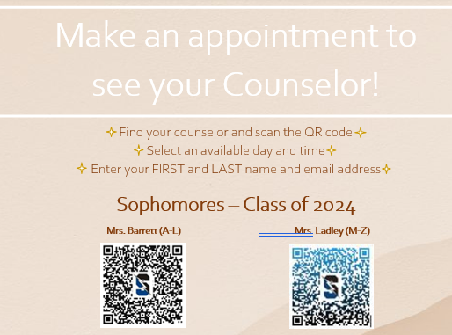
Getting to know US & CB South
Counselors
Our Role
Appointments
Goal: Prepare students for life beyond HS
Self-advocacy, Working through discomfort, Managing their time (school/work/activities), Communicating w Adults)
Information Sessions for families
Communications
Mr. Bucher’s Newsletters
Daily Announcements (on website/QR Scan)
Class of 2024 Canvas page (you can join!)
Class of 2024 Parent FB Page (unofficial)
Class of 2024 Instagram (Student/Advisor-lead)
CBSD/South/Naviance emails
Notes:
We encourage students to reach out whenever they have a question, in person whenever possible, so we get to know them!
Please encourage your student to seek us out if they have questions. As much as it is easy for a parent to just do it for them, this is part of our goal to increase our students' self-advocacy and prepare them with skills that will help them beyond HS. This also includes encourages them to learn how to manage their time, make decisions about when to schedule appointments, avoiding certain class times, seeking out resources, and communicating with adults.
Students can stop down to the House Office to see their counselor before school, after school, during L&L, or can scan the QR code found all over the building to put themselves on our calendars. Students have full access to our calendars through MS Bookings so they can see us when it is convenient for them.
Counselors will utilize email blasts and Mr. Bucher's newsletter to communicate important information to families. Please do not skip over emails that come from CB South and do make it a point to read the Newsletter every Friday. We also use the Class of 2024 Canvas page to post important dates, events, notifications (Parents can see this as a Canvas observer just as they can any of their classes). Daily announcements can be found on the CB South main page. There are Giant QR Codes posted around the building for kids to scan to see announcements.

Slide 3
Sobering Statistics From "When a College Student Comes Home to Stay"
Thirty percent of freshmen won’t return for their sophomore year, and the wheels can start to fall off as early as Thanksgiving".
Only 20 percent of students complete a bachelor’s degree in four years.
Only 57 percent of students who enroll in college will graduate in six years.
One out of every three freshmen reports symptoms of a psychological disorder, and the number of students seeking mental health care on campus is increasing rapidly.
62 percent of undergrads reported feeling “overwhelming anxiety".
"If you question your teenager’s readiness for college at the end of high school, you cannot expect that he or she will be ready by fall. It takes time, practice and some failure to learn how to run a life. And you don’t want your child to learn these lessons in an environment that is as toxic as it is expensive."
Notes:
We referenced an article in the NY Times “When A College Student Comes Home To Stay” which talks about the increasing number of students who go off to college but cannot make it through a year because they are ill equipped to deal with the independence and decision making that they face away from home.
Not everyone "has to" go to college, nor do they want or need to. We very much want to listen to what our students are saying and meet them "where they are at"/.

Slide 4
Partnering with Us…
“Real Talk” – Engaging your teens in conversation
Cell phone use (putting them away at night/ limit time)
Vaping
Drugs & Alcohol
Making good decisions
Preparing your teen now for the future
Attendance/Being on Time
Self-Advocacy/Communication Skills
Time-management/Organization
Independence
Problem-Solving through challenges/discomfort (fight, not flight!)
Social Media Footprints
Mental Health check ins
Notes:
We understand that as students enter high school, there is a natural “push” to be more private or independent. We often hear from parents that their teens do not give them much information about what is happening in their lives and they begin to shut their parents out from sensitive conversations. While this is natural in a lot of ways, we strongly encourage parents to push conversations about what their kids are seeing and experiencing.
Gone are the days where “a certain type of kid” is making poor decisions about risky behaviors. Vaping, using marijuana, and binge drinking are more mainstream than ever as indicated in the PAYS survey. The number of students impacted by mental health issues is dramatically rising While students must begin to make their own decisions, they are still just teens with (often times) weak decision-making skills.
Students will readily admit that they will not initiate conversation about the things they are seeing or hearing about, but will engage in conversation if a parent asks. As we (as a school) try to address the growing concerns about risky behaviors, we ask that parents continue to partner with us to continue those conversations.
Counselors also ask parents to partner with us on reinforcing very important life skills as we prepare our teens for the “real world”. Having conversations about the importance of attendance, promptness, self-advocacy, proper ways to communicate, managing their time, making good choices, and finding ways to organize their work and social life is crucial for students to learn now.

Slide 5
Lunch & Learn
Instituted just three weeks ago
Learning curve
Purpose
SEW, Autonomy, Time Management, Academic Support, Time with Friends
Guidance Lessons
Standardized Testing
AP Testing Q&A
College Application Q&A
Gap Year Conversation
SEL opportunities (mental health, culture, theme months)
Notes:
Counselors discussed L&L and the kinds of opportunities students can take advantage of.

Slide 6
Career Readiness
Naviance
College & Career Resource
College Searches/Matches
Career Research
Success Plan- Details on next slide
MBIT
Enrichment Opportunities
Notes:
There are a variety of career and college tools in Naviance that parents and students can explore. In CB our College & Career Platform is called Naviance, which students began using back in 9th grade for Success Plan. As they move into Junior and especially Senior years, students will be utilizing this platform much more. But we encourage students to explore all the features in there beyond what is expected of them through Success Plan each year.
The Naviance tasks that students will complete as part of their Success Plan this year will give students feedback on which careers match their personality type, interests, and aptitude. In Junior Year, we have students look at how their interests relate to majors and different college options. Senior year we touch upon important topics like Financial Literacy. We encourage parents to talk to their students about the results of their Success Plan.
Summer Enrichment Opportunities that are sent to CB South will be posted under the “Colleges” – “Enrichment Opportunities” section of Naviance. We have had many students research and attend other programs for personal enrichment that are not advertised in Naviance. If a student has an interest in finding programs in a specific academic area, we advise them to network with family members, talk to teahers in case they are aware of programs in their discipline, or simply google high school enrichment Philadelphia area, etc.
There are a number of career-subject related clubs that are held after school and we encourage students to join those clubs for additional career exploration. (See CB South webpage for full list of all clubs/activities).

Slide 7
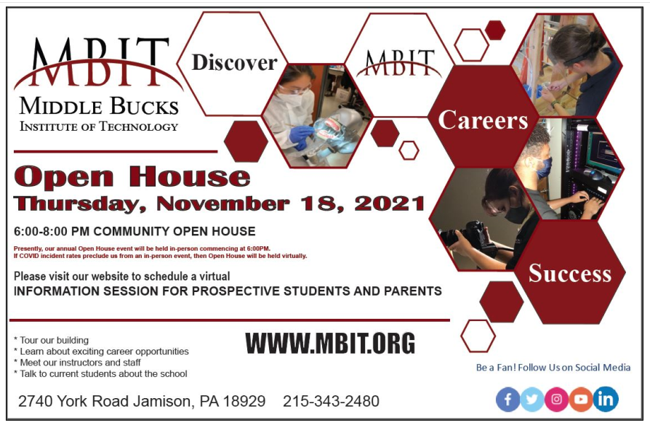
Notes:
We highly encourage students and their families to check out the offerings at MBIT. Over 85% of our students who attend MBIT go on to study at the collegiate level after high school.

Slide 8
Success Plan
Important for Career Readiness
Naviance was introduced to students in 9th grade for SP9
Success Plan is a graduation requirement
Tasks done independently
TF Mentor supervises progress/completion
Notes:
Success Plan activities provide students with critical feedback towards career exploration. This year, sophomores will discover their personal skill strengths so they can make connections how certain careers align with their strengths and interests. We also have our sophomores build their resume each and every year so that by the time they graduate, they can have a workable resume for job and college applications.
SP tasks are required each year and are a Graduation Requirement. Tasks must be done INDEPENDENTLY, however TF Mentors will introduce tasks and monitor completion. Anything not completed must be done independently as this is a graduation requirements.

Slide 9
College Readiness
Sophomore Goals
Resources
Determing Post-Sec Goals & Interests
Focus on Grades & Academic Choices
Involvement
Establish Connections with Teachers
Developing Good Work Habits & Self-Advocacy
PSAT/PreACT/AP if applicable
College/Career/Tech
Naviance
School Counselors
CollegeBoard
Lunch & Learn Activities
Notes:
It's important for students and their families to make the most of each year leading up to graduation. Students may be on their own timeline and have different goals, but generally speaking we suggest students focus on a few things Sophomore Year as they begin to determine post-secondary goals.

Slide 10
PSAT Results
College Board distributes scores by region online in December- student will get email alert to login.
KEEP LOGIN HANDY- Students will use this login to register for SATs in the spring of Junior Year.
Khan Academy- online prep tool that students can also use for SATs (FREE!)
Pre-ACT will be offered to Sophomores (only) this spring.
Notes:
PSAT results will be released mid-December. Counselors encourage students to create a College Board login since they will need to do so in order to see results. They will also need to save this login and password to register for SATs in the future or see future PSAT and SAT results. It is imperative that they do not create more than one College Board login in their HS career otherwise scores will be held in different identities. Khan Academy can be a great practice tool for PSAT and SAT, and can be accessed through their College Board account to get personalized preparation.
PRE-ACT will be offered this spring to sophomores only. It is similar to the PSAT in that it is purely practice, isn’t put on any school records, and can help students determine if they like/prefer the ACT.
**The ACT and SAT are EQUALLY accepted by ALL universities so it is truly the student’s choice whether they want to take the SAT, ACT or try both for college admissions. Since the pandemic, we have seen many colleges abandon the testing requirement, but it is too early for colleges to say what will happen for our 2024 grads.

Slide 11
We hope to see you again…
Early College Planning
Program Planning, PreACT
Summer Plans, Fostering Independence
College Resources, Prepping for Junior Year
Notes:
We hope parents will be able to join us for two more Coffee and Conversation sessions this spring. We were excited to see so many parents at this session!

