Slide 1
Welcome----http://www.cbsd.org/formative
Please sign in on the blue sheet
Create a name plate
Go to http://www.cbsd.org/formative and make it a favorite.

Slide 2
Formative Assessment Using Technology
Goals for today:
To learn about why and how technology can help with formative assessment
To expose teachers to some online formative assessment tools
To give teachers time to learn how to use these tools

Slide 3
The formative assessment toolkit
https://getkahoot.com
https://www.plickers.com/
http://socrative.com/
Backchannel Chat
http://www.zipgrade.com/
https://www.polleverywhere.com/

Slide 4
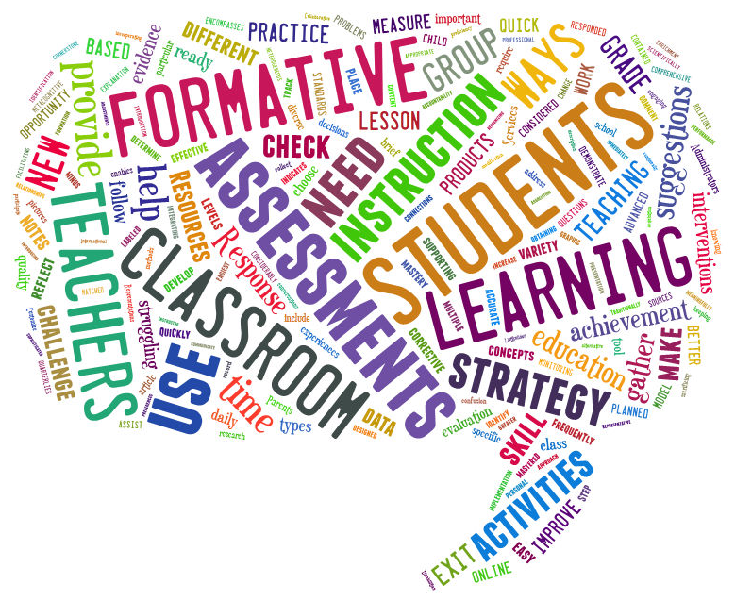
Formative Assessment Using Technology
What is formative assessment?

Slide 5
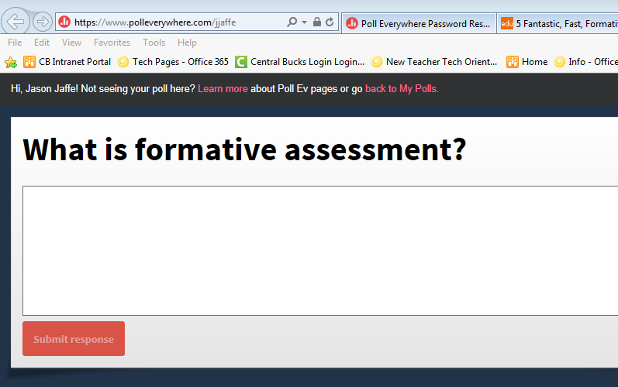
Formative Assessment Using Technology
https://www.polleverywhere.com/jjaffe
What is formative assessment?

Slide 6
Formative Assessment Using Technology
What is formative assessment?
Formative assessment is a tool teachers use to give feedback to students and/or guide their instruction. It is not included in a student grade, nor should it be used to judge a teacher's performance.
Danielson Rubric: ~1d: Demonstrating knowledge of resources The teacher’s knowledge of resources for classroom use and for extending one’s professional skill is extensive, including those available through the school or district, in the community, through professional organizations and universities, and on the Internet.

Slide 7
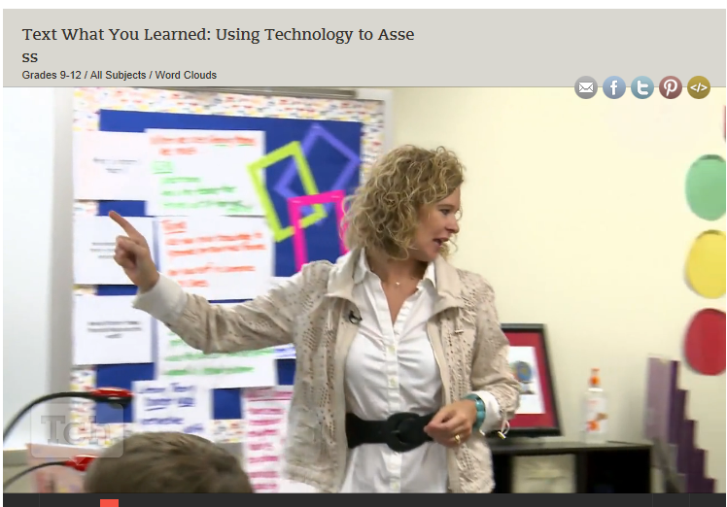
PollEverywhere.com
Questions to Consider
How does polleverywhere benefit both the teacher and the students during the lesson?
If students do not have cell phones, how could you adapt this strategy?
How does using a word cloud add to this strategy?

Slide 8
PollEverywhere.com
Questions to Consider
How does polleverywhere benefit both the teacher and the students during the lesson?
If all your students don't have cell phones, how could you adapt this strategy?
How does using a word cloud add to this strategy?
Danielson Rubric ~ 3c: Engaging students in learning Virtually all students are intellectually engaged in challenging content through well-designed learning tasks and activities that require complex thinking by students. The teacher provides suitable scaffolding and challenges students to explain their thinking. There is evidence of some student initiation of inquiry and student contributions to the exploration of important content; students may serve as resources for one another. The lesson has a clearly defined structure, and the pacing of the lesson provides students the time needed not only to intellectually engage with and reflect upon their learning but also to consolidate their understanding.
https://www.polleverywhere.com/jjaffe

Slide 9
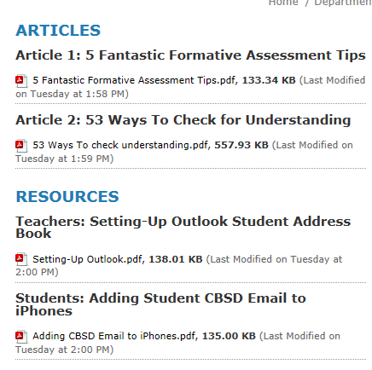
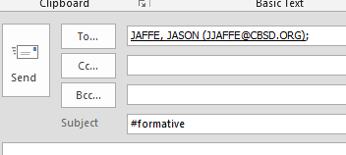
Activity 1
http://www.cbsd.org/formative
Find a partner and read Article 1
Discuss the article with a partner and highlight two important sentences.
With your partner, email the answer to this question: Which tool mentioned in the article have you or your partner used and how have you used it?
4 minutes

Slide 10
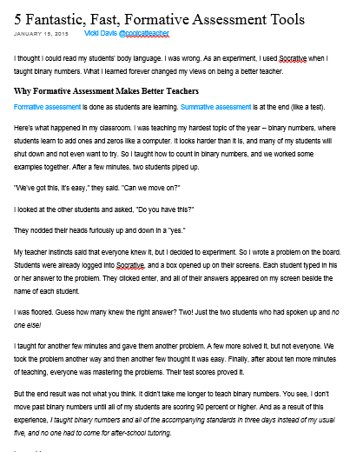
What did you highlight?
Good teachers in every subject will adjust their teaching based upon what students know at each point.
Good formative assessment removes the embarrassment of public hand raising and gives teachers feedback that impacts how they're teaching at that moment.
Test scores should never be a surprise. You don’t need to be a mind reader. You just need a formative assessment toolbox, and you need to use it every day.

Slide 11
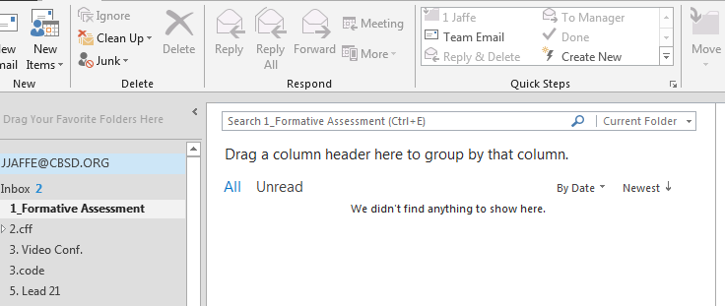
What did you email?

Slide 12
The formative assessment toolkit
https://getkahoot.com
https://www.plickers.com/
http://socrative.com/
Backchannel Chat
http://www.zipgrade.com/
https://www.polleverywhere.com/

Slide 13
ZipGrade--https://www.zipgrade.com/
“Use your smartphone to immediately know what students know with a snap of a picture.”

Slide 14
ZipGrade--https://www.zipgrade.com/
Who was the first African-American Major League baseball player?
Willie Mays
Jackie Robinson
What famous geyser might you get to observe if you visit Yellowstone Park?
Old Faithful
Rusty Scupper
Prior to being elected President, for which state did President Franklin D. Roosevelt serve as governor?
Maryland
New York
Virginia
What is the value of 7 cubed, or 7 to the third power?
49
181
345
343
By purpose, how is the following sentence classified? “Take out the trash, please.”
Imperative
Declarative
Interrogative
Exclamatory

Slide 15
BREAK
15 minutes
End

Slide 16
The formative assessment toolkit
https://getkahoot.com
https://www.plickers.com/
http://socrative.com/
Backchannel Chat
http://www.zipgrade.com/
https://www.polleverywhere.com/

Slide 17
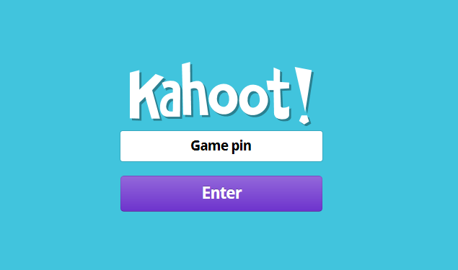
Kahoot about article
Danielson Rubric ~ 3d: Using Assessment in Instruction Assessment is fully integrated into instruction, through extensive use of formative assessment. Students appear to be aware of, and there is some evidence that they have contributed to, the assessment criteria. Questions and assessments are used regularly to diagnose evidence of learning by individual students. A variety of forms of feedback, from both teacher and peers, is accurate and specific and advances learning. Students self-assess and monitor their own progress. The teacher successfully differentiates instruction to address individual students’ misunderstandings.

Slide 18
Email Me---Quick Check in
Email: Give an example of a lesson or unit you could use Kahoot.
“Backchannel chat -- a live chat that accompanies class discussion -- is a great way to do exit ticket activities. While these chat tools aren't anonymous they can be powerful.”

Slide 19
The formative assessment toolkit
https://getkahoot.com
https://www.plickers.com/
http://socrative.com/
Backchannel Chat
http://www.zipgrade.com/
https://www.polleverywhere.com/

Slide 20
The formative assessment toolkit
https://getkahoot.com
https://www.plickers.com/
http://socrative.com/
Backchannel Chat
What is Plickers? Plickers is a free app for a phone or tablet that lets teachers collect real-time formative assessment data without the need for student devices.

Slide 21
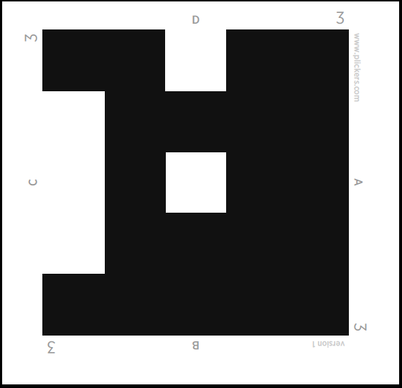
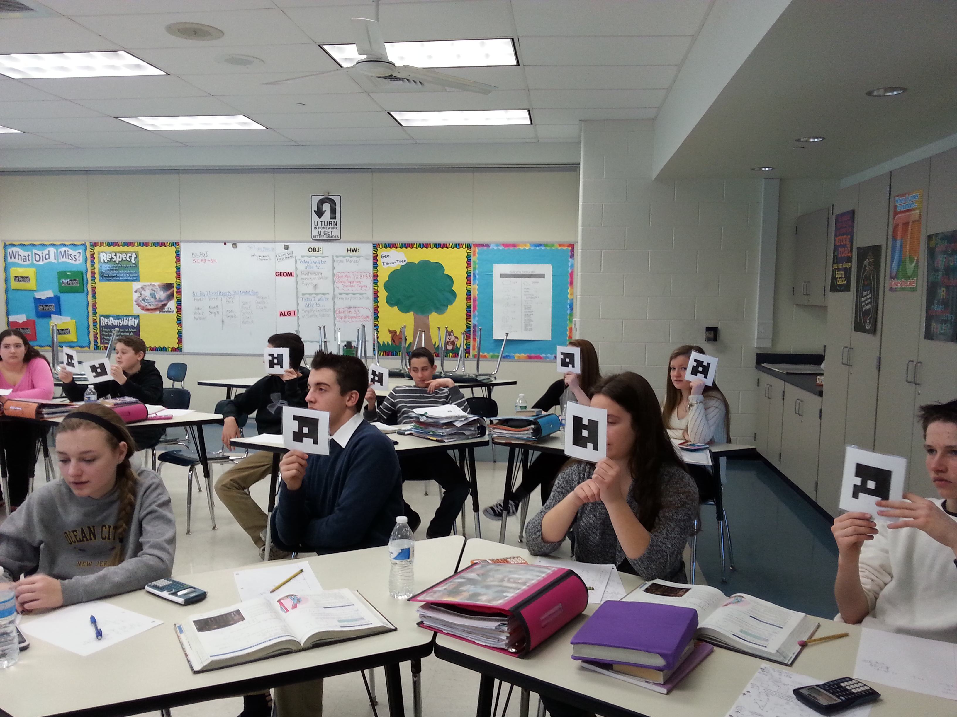
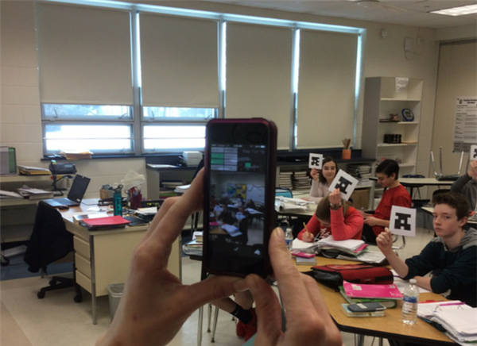
www.plickers.com/ (works best in Firefox)

Slide 22
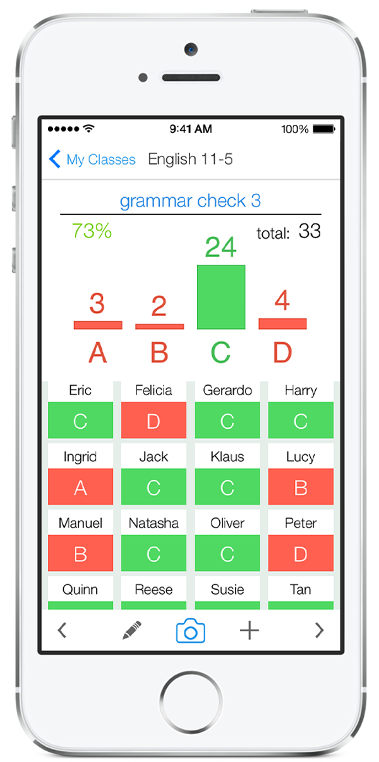
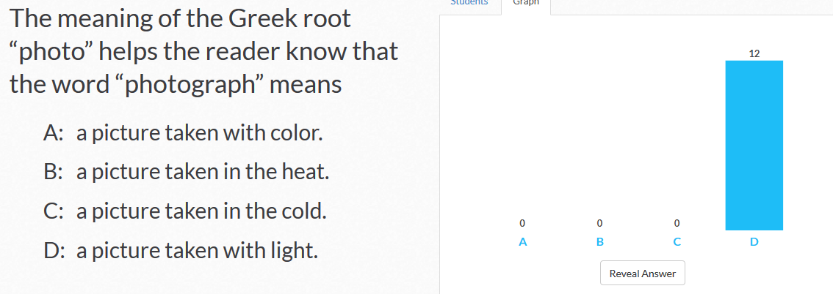
www.plickers.com/ (works best in Firefox)

Slide 23
Plickers
Danielson Rubric ~ 3d: Using Assessment in Instruction Assessment is fully integrated into instruction, through extensive use of formative assessment. Students appear to be aware of, and there is some evidence that they have contributed to, the assessment criteria. Questions and assessments are used regularly to diagnose evidence of learning by individual students. A variety of forms of feedback, from both teacher and peers, is accurate and specific and advances learning. Students self-assess and monitor their own progress. The teacher successfully differentiates instruction to address individual students’ misunderstandings.

Slide 24
www.plickers.com (Use Firefox)
Danielson Rubric ~ 3d: Using Assessment in Instruction Assessment is fully integrated into instruction, through extensive use of formative assessment. Students appear to be aware of, and there is some evidence that they have contributed to, the assessment criteria. Questions and assessments are used regularly to diagnose evidence of learning by individual students. A variety of forms of feedback, from both teacher and peers, is accurate and specific and advances learning. Students self-assess and monitor their own progress. The teacher successfully differentiates instruction to address individual students’ misunderstandings.
Patrick Wheeles “Plickers works great to review before tests so I can demonstrate good techniques when dealing with tough multiple choice problems.”
“I also love that it records everyone’s answers and preserves them. This allows me to see how every student is doing and students can’t hide in the classroom.”

Slide 25
The formative assessment toolkit
https://getkahoot.com
https://www.plickers.com/
http://socrative.com/
Backchannel Chat
http://www.zipgrade.com/
https://www.polleverywhere.com/

Slide 26
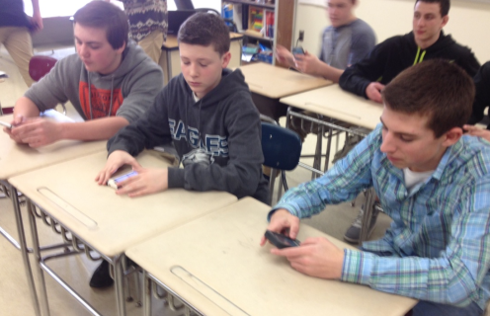
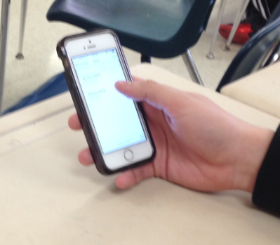
Student Email
Why use it? Student email using Office 365 is a secure, easy, and effective way to engage students as well as assess progress during a lesson.
Notes:
Lisa mentioned that she found her students were more apt to email her once she set this up. And that she felt they were learning valuable advocacy skills and it helped her know more about what they were confused about…even if she didn’t use it for closure

Slide 27
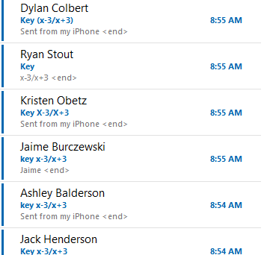
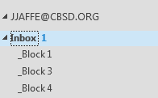
Student Email
Name
Time
Answer
Key Word

Slide 28
Student Email
Formative Assessment Tool
Extra Practice
Closure
Touch Base With Every Student
Preview Their Work Before Class
Set-Up Time So Minimal
One Folder For Each Class

Slide 29
Student Email
Holicong 9th Grade Student “Email is easy to use in my math class. It is fun when we race to get our answer in first. It is helpful seeing everyone’s answer.”
Danielson Rubric ~ 3c: Engaging students in learning Virtually all students are intellectually engaged in challenging content through well-designed learning tasks and activities that require complex thinking by students. The teacher provides suitable scaffolding and challenges students to explain their thinking. There is evidence of some student initiation of inquiry and student contributions to the exploration of important content; students may serve as resources for one another. The lesson has a clearly defined structure, and the pacing of the lesson provides students the time needed not only to intellectually engage with and reflect upon their learning but also to consolidate their understanding.

Slide 30
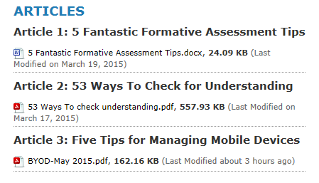
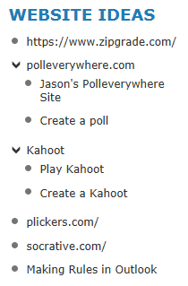
Activity 2
http://www.cbsd.org/formative
Create groups of 3 people and read Article 3.
Discuss the article and come up with 3 questions to poll the teachers in this workshop.
Use one of the tools listed below to create a Formative Assessment Activity for the group. You can pick any strategy. You will present it.
4 minutes

Slide 31
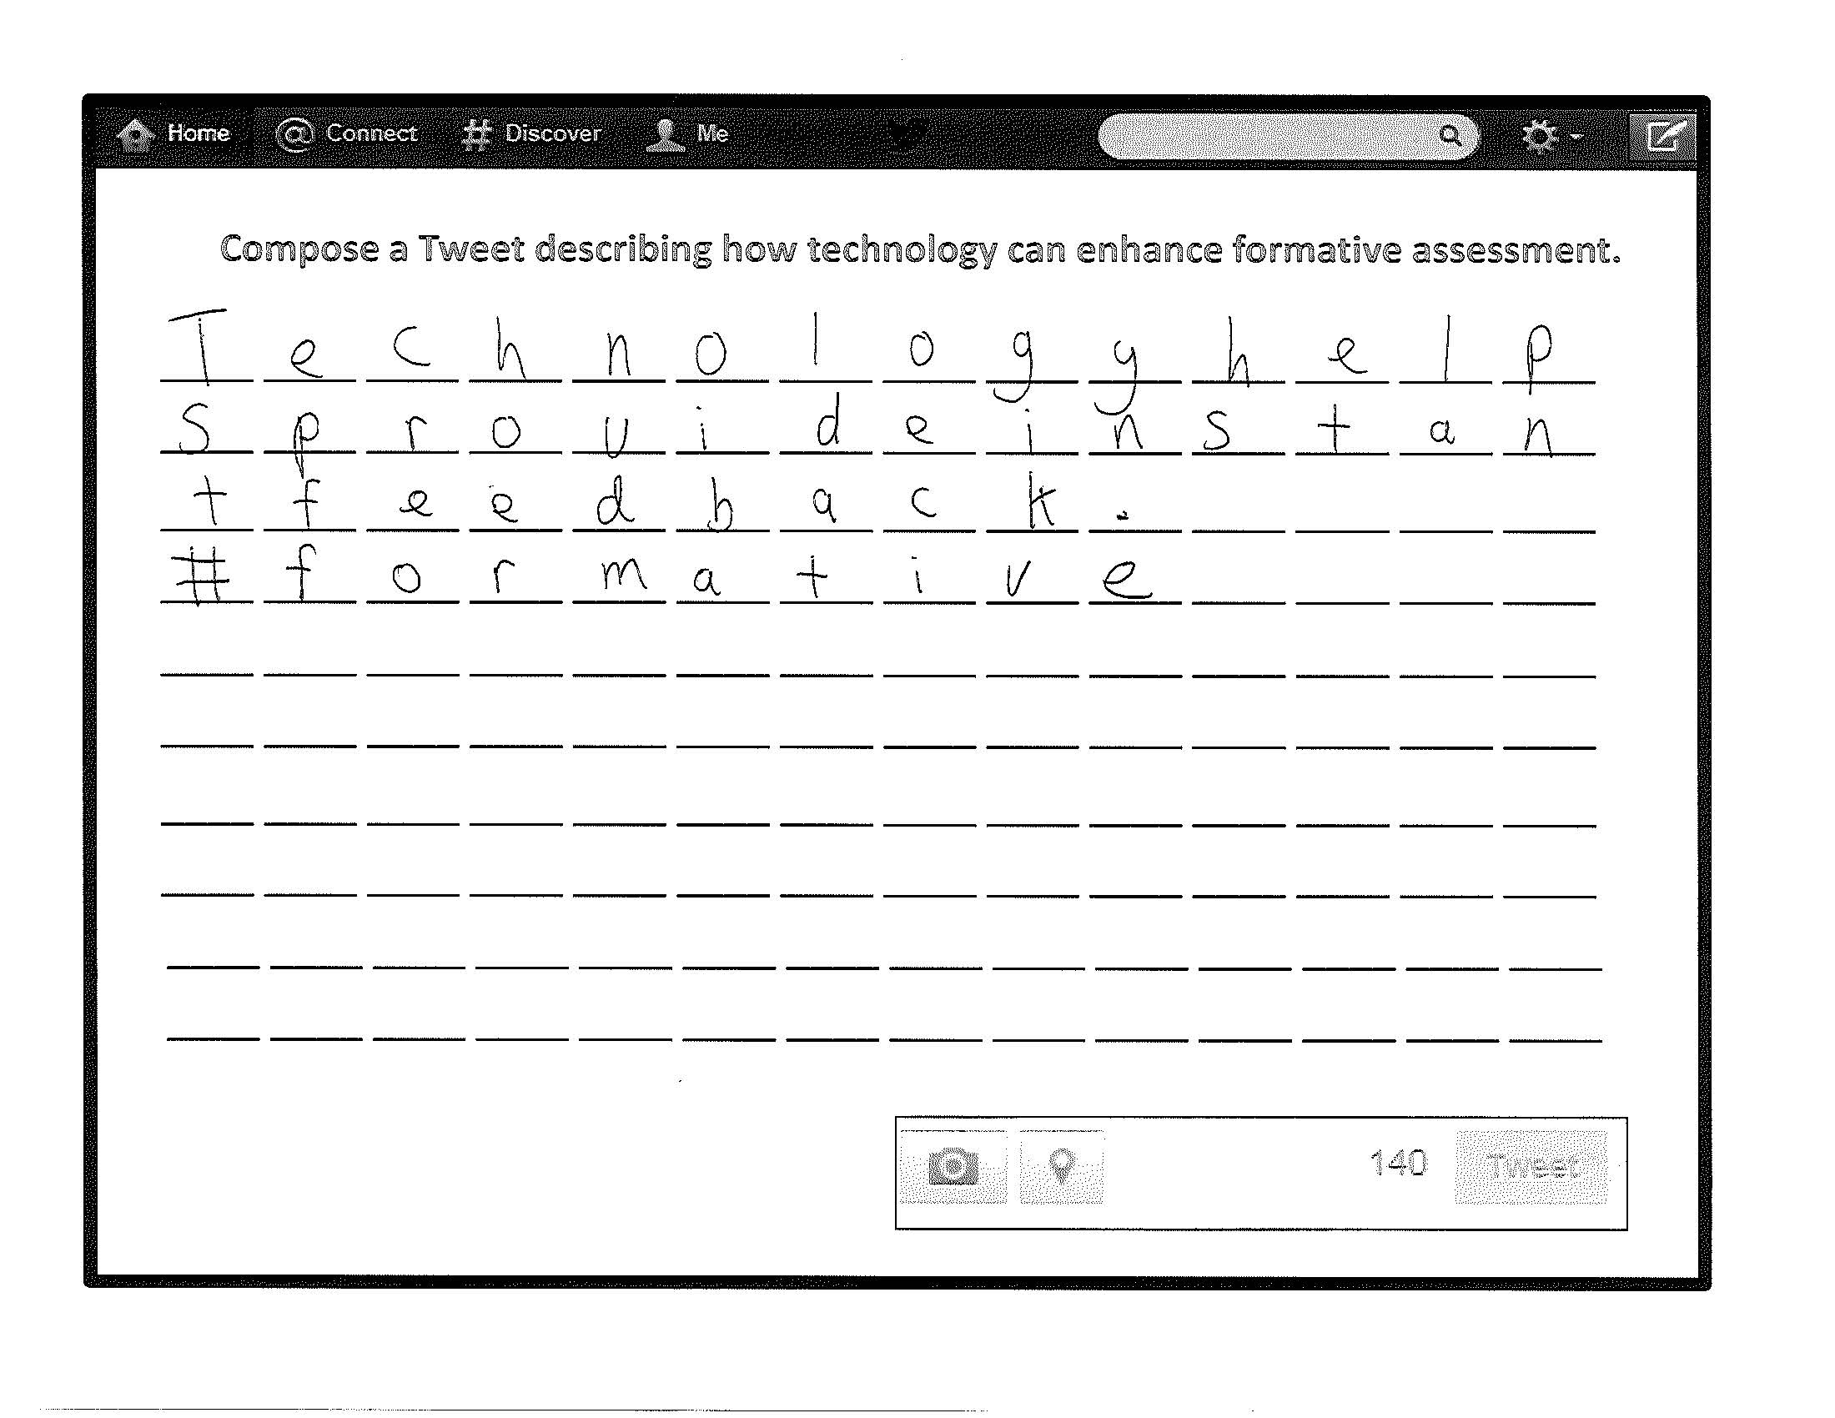
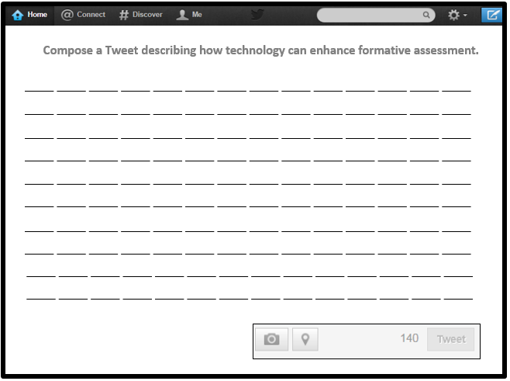
Closing Tweet

