Slide 1
Post-Secondary Planning
Juniors Class of 2026
Testing & College Search

Slide 2
AGENDA
Junior Year Timeline
Standardized Testing
College Search Process
Resources

Slide 3
Junior year timeline
​ | Fall​ | Winter/Spring​ | Summer​
Testing​ | PSAT October. ​ AP Registration (for MP1 APs).​ | Take the SAT/ACT . AP Registration (for MP2-MP4 APs). | Register for fall SAT/ACT as needed.​ ASVAB for those considering military.​
Naviance​ | Research careers/majors in Naviance. Begin building list of colleges you're thinking about. Update resume. | College search process. ​ Update Resume. Continue to build list of colleges you're thinking about. | Student & Family Complete “Counselor Recommendation Survey".​ Update Resume.
College​ | Meet with College Admission Reps Visiting South.​ ​ | Attend Open Houses @ Colleges.​ Tour Colleges.​ College Fairs.​ View Online Virtual Tours.​ | Set up Campus Tours and Visit Schools of Interest.​ Begin College Applications.​
General​ | Create helpful accounts:​ E-Prep (Library)​ College Board/ACT​ Khan Academy and ACT Academy​ | Inquire about recommendations from 11th grade teachers.​ Save college essay and graded writing sample.​ Program Planning.​ | Write/Edit College Application Essay.​ Update Resume.​ ​

Slide 4
College-Related Testing Timeline
PSAT
SAT/ACT
Advanced Placement
(AP) Tests
Winter/Spring junior year; Summer/Fall senior year; Immediately after prep course. *Register through ACT/College Board
October
Review results online (Nov) to prepare for future SAT
First 2 weeks of May; same year as AP course

Slide 5
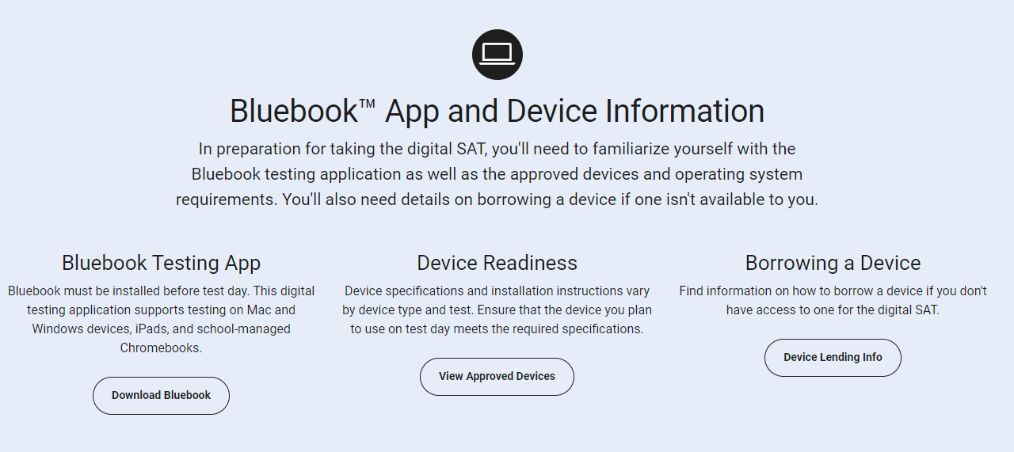

Slide 6
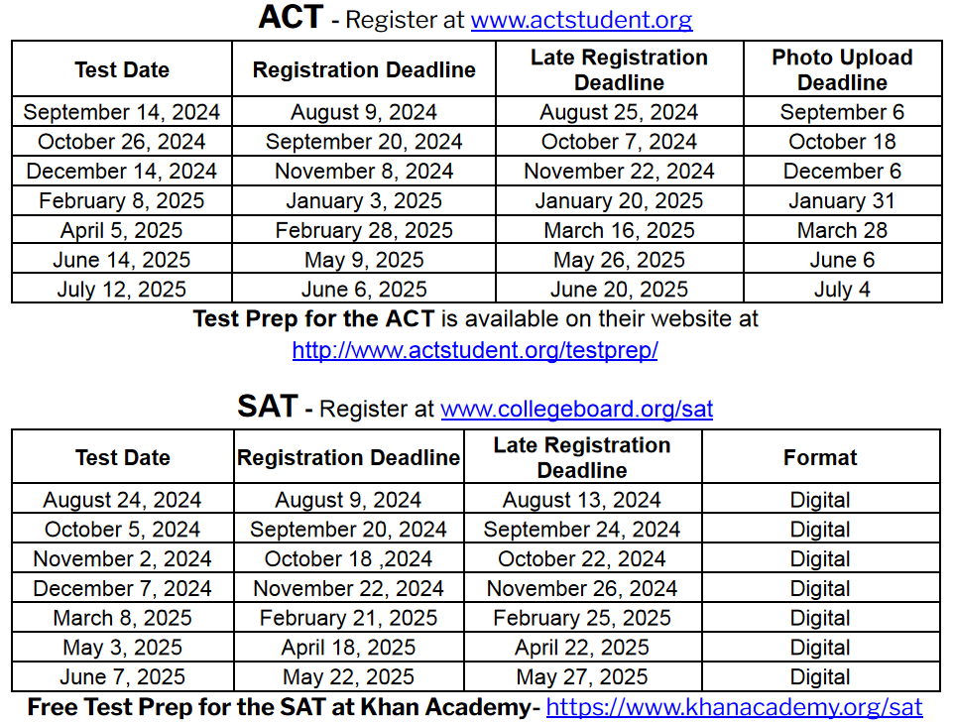

Slide 7
Test prep resources
Fairtest.org
ACT Academy
Through ACT
EPrep
Khan Academy
Private test Prep
CB South Electives
See CB South Librarian
Through CollegeBoard
Math and English

Slide 8
Reporting Test Results to Colleges
Directly to college from testing company upon student request
May take up to 4-6 weeks
When registering for tests, students can request scores be sent to up to 4 colleges for FREE. Scores rec’d by college in 2 weeks
Test scores are NOT ON YOUR TRANSCRIPT
Is “Score Choice” the right choice or should I send all scores?
“Super-scores” are calculated by most colleges
Official
Score
Reports
Growing trend in admissions
Option to take picture of score report and submit
Official score report required by college you choose to attend
Self-Report
When registering for any standardized test, be sure to include
CB South school code 394-992 and check Parent Portal to make sure scores have been sent to South to include in your Naviance statistics.

Slide 10
When? Typically 1st 2 weeks of May @ CB South during school day.
How? Register through Mypaymentsplus
Cost? $104
Course registration and payment deadline varies based on when AP course began
Potential benefits of AP
College credit
Course level placement
“Place out” of college courses.
Advanced academic standing
Rigorous preparation for college coursework
Who takes AP Credits?
www.collegeboard.org/ap/creditpolicy

Slide 11
A Valuable Resource
An online notebook to do research, track your progress, keep personal records...
Research
Colleges
Careers
Scholarships
Enrichment & Summer Programs
Analyze & Compare Data
Visit College Websites
Requesting Transcripts and Letters of Recommendation Senior Year

Slide 12
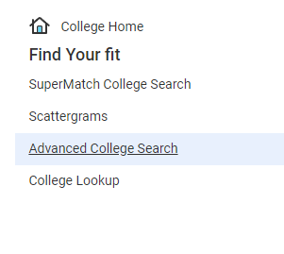
The College Search Find Your Fit...
Selection Criteria
2 or 4 year
Academics
Competitiveness/Admissions
Public vs private
Size
Cost
Coed vs single sex
Enrollment
Location & distance from home
Religious affiliation
Sports & Divisions & Intramurals
Diversity
Resources/Opportunities

Slide 13
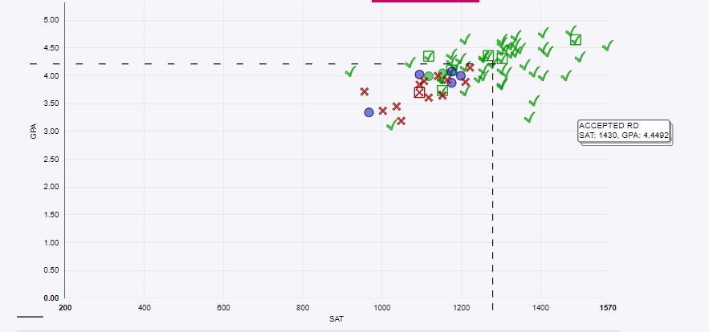
Research & Comparison Tools
Keep track of your research in one place.
Colleges I’m Thinking About
& Scatterplots

Slide 14
Check Out the Statistics

Slide 15
Online College Search Tools: Ratings, Discussion Boards, Search Engines
College Board/Big Future
Common App/Explore Colleges
Cappex
Unigo
Niche
TheCollegeTour.com
College Confidential
College Navigator
HS Navigator
US News and World Report’s Best Colleges Report
The Princeton Review
Forbes Magazine’s America’s Top Colleges
Kiplinger’s Best College Values

Slide 16
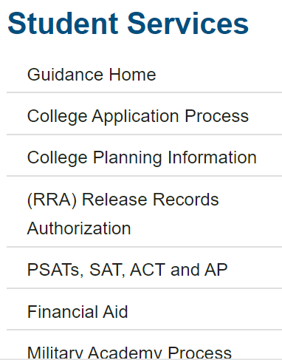
RESOURCES
Student Services Webpage
Naviance- College and Military visits, Statistics, College Search tools, Virtual campus tours
School Counselor – Students should schedule individual appointments
Open House Bulletin Board
College Rep Visits
Check your CBSD email!
ACT and College Board (SAT & PSAT) websites

